Slide 1

Report on Machine Learning Results and Feature Selection
EMG DATA
Subject 1 – Subject 10
Dataset 1

Slide 2
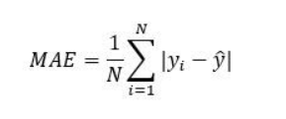
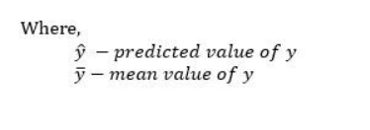
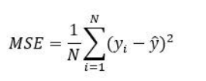
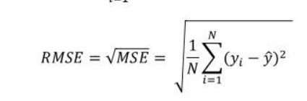

Newly Added 4 other Evaluation Parameters
The Mean absolute error
Mean Squared Error
Root Mean Squared Error
F1 Score (Weighted)

Slide 3
Classification Result Evaluation

Slide 4
Error Rate Calculation

Slide 5
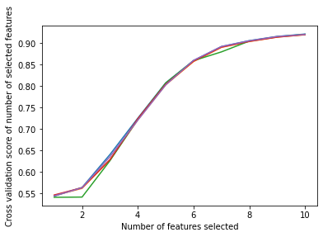
Feature Selection Result (Subject 1-10)
Features | Boruta Feature Selection
Emg 1 | True
Emg 2 | True
Emg 3 | True
Emg 4 | True
Emg 5 | True
Emg 6 | True
Emg 7 | True
Emg 8 | True
Emg 9 | True
Emg 10 | True
 | Least Important Feature
Subject 1 | Emg6
Subject 2 | Emg6
Subject 3 | Emg5
Subject 4 | Emg5
Subject 5 | Emg1
Subject 6 | Emg1
Subject 7 | Emg1
Subject 8 | Emg1
Subject 9 | Emg5
Subject 10 | Emg1
Figure : How Accuracy is Increasing by Selecting each Features (Wrapper Method : RFE Feature Selection)
Table : Least Important Feature Selected by ANOVA + Random Forrest Feature Importance
Table : Optimal Number of Feature Selected by Boruta Feature Selection (Wrapper Method)

Slide 6
Feature Selection Accuracy and Error Rate Result

Slide 7
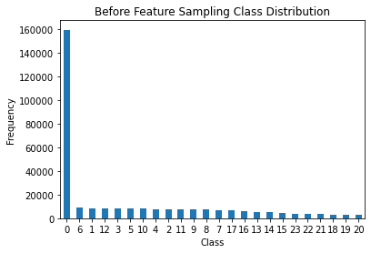
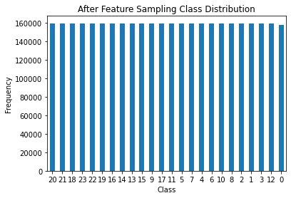
Scopes of Improvements
 | Base Accuracy | Tuning | Oversampling | Smote Tomek
Random Forest Classifier | 93.367 | 93.602 | 92.526 | 93.504
K-Nearest Neighbours | 90.472 | 92.513 | 88.803 | 86.32
XGBoost | 88.527 | 92.636 | 82.196 | 86.588
Decision Tree | 85.54 | 86.178 | 83.972 | 86.361
Table : Accuracy Score (Subject 1)

Slide 8
Thank You

